Slide 1
Faculty Learning Community Diversity in the Classroom: Enhancing the Curriculum and Environment Co-Facilitators: Eileen O’Brien Julie Murphy

Slide 2
Joanna Gadsby Library Instruction Coordinator & Reference Librarian
Problem: New National Standards
Needed to incorporate new national framework of information literacy standards, including:
Contextual & constructed nature of authority
Reasons (how & why) some individuals/groups are underrepresentated/marginalized within systems that produce and disseminate information
FLC-Facilitated Solution: New Lesson Plans
Based on feedback & discussion w/FLC, designed new lesson plans for library instruction
Pilot tested new lesson plans with students of FLC members
Now integrating these lesson plans with department-based library instruction curriculum

Slide 3
Mary Tabaa Clinical Instructor, M.A. TESOL Program
Problem: Limited Incorporation of Diversity
Main diversity focus in M.A. TESOL program has been in the K-12 certification internship, but not all students take this internship
To better meet the needs of students, needed to incorporate cultural and linguistic diversity focus into the Instructional Design course, which all students take
FLC-Facilitated Solution: Curriculum Enhancement
Incorporated readings, discussions, and application activities on Universal Design for Learning, Funds of Knowledge Approach, and Critical Pedagogy.
Next semester, plans to include more background on ESOL & Special Education.

Slide 4
Kimberly R. Moffitt Associate Professor, American Studies
Problem: Teaching Intersectionality
Needed an assignment that enables students to understand the complexity of intersectionality (gender, race, class, etc.)
Many students “shut down” or do not engage because of the professor’s gender and race
Wanted to use assignment in core AMST course that meets both AMST and GEP requirements
FLC-Facilitated Solution: Baltimore as Case Study
For assignment, students will:
explore Baltimore Uprising through semester-long group project.
take on an assigned “role” to research (e.g., resident, media, business owner, police officer, etc.)
complete short writing assignment with call to action(s) or demand(s)
Participate in simulated Town Hall meeting with goal of generating specific deliverables and next steps that are mutually beneficial to all parties
Guest speakers representing different roles in community (e.g., resident, media, business owner, police officer) will present perspectives
Town Hall meeting will be recorded to share with future classes & other interested parties
Notes:
Speaking notes: Intent of project is to enable students to learn of lived experiences by embodying “roles,” rather than simply sharing information that may be construed as partial or biased.

Slide 5
Susan Sonnenschein Associate Professor (Psychology), GPD (Applied Developmental Psychology)
Problem: Differences / Weaknesses Focus
Majority of research on children’s educational development focuses primarily on differences/weaknesses found in diverse populations
Strengths-/resiliency-based research is harder to find
Broadest base of knowledge would include both perspectives.
FLC-Facilitated Solution: Curriculum Enhancement
Plan to work with undergraduate research assistants (PSYC 398) to update curriculum for PSYC 409 (WI, capstone course, Development & Education)
Will enhance the education of undergraduate RA’s by teaching critical evaluation of literature and sophisticated searching / critiquing skills
Students in PSYC 409 benefit from enhanced readings that provide broadest base of knowledge

Slide 6
Pamela Monaghan-Geernaert Visiting Lecturer, Sociology
Problem: Lack of Training in Diversity / Microaggressions
Sociology classes discuss sensitive topics related to diversity
Professors not necessarily trained in dealing with classroom microaggressions
Professors tend to individually resolve microaggressions & classroom problems without consultation with colleagues
FLC-Facilitated Solution: Department Diversity Workshop
Create a monthly symposium for the department focused on topics of diversity (i.e. race; sexual orientation)
During the symposium have faculty share their classroom best practices.
Compile a list of videos, news clips, books and other resources colleagues use in class to teach diversity
Also, post & link any FLC or FDC workshops that address diversity to Dept website
Network with other Depts to share best practices & resources

Slide 7
Karen Whitworth Lecturer, Biological Sciences
Problem: Unknown Student Outcomes by Demographic Group
Large class sizes limit understanding of individual differences in learning needs and outcomes for diverse student populations in BIOL
Question: Are there differential outcomes for particular populations?
If so, how can we improve course performance among diverse student populations?
FLC-Facilitated Solution: OIR Data Collection & Analysis
Basic demographics and outcome data (grades) are available through OIR
Will collect data to determine:
Relationship between demographic variables and student learning outcomes across BIOL courses
Determine best practices to build upon various strengths and experiences of diverse populations
Identify whether there are specific student populations are being under-supported in curriculum

Slide 8
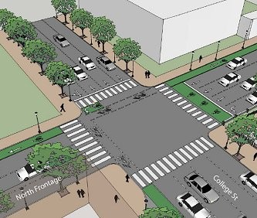
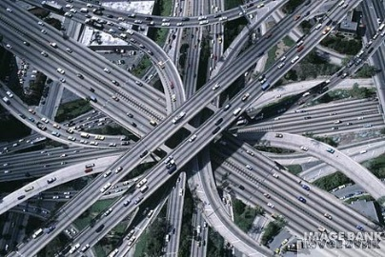
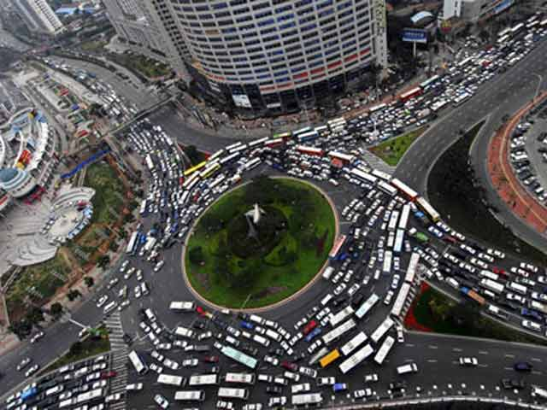
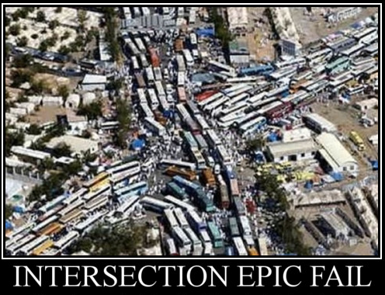
Jason Schiffman Associate Professor, Psychology (teacher, researcher, search committee member, co-chair of Dept. ECD, father, community member)
Problem: Multiple Roles Needed Enhancement
Initial vision in starting with FLC (“didn’t know what I didn’t know”):
Emotional reality:
FLC-Facilitated Solution: Overall Enhancement
Improved understanding of real-life complexity:
New aspirations:
Evolving enhancements and aspirations: New readings in classes, better leadership, incorporation into research, better conversations with applicants, better discussions in other classes, fatherhood challenges, community involvement

Slide 9
Eileen O’Brien Senior Lecturer, Psychology
Problem: New Concentration in Diversity / Multiculturalism
PSYC Dept decided to develop new concentration in psychology major: Diversity & Multiculturalism
Served on committee to develop the guidelines / requirements for completing this concentration
FLC-Facilitated Solution: Collaboration & Best Practices
Identified courses taught by FLC members that fit into new concentration
Identified courses & categories in other disciplines for new concentration
Shared empirically-tested best practices
Reviewed courses covering a broader context of diversity
Collaborated on May 2015 proposal
New concentration proposal approved by Dept faculty on May 4!

Slide 10
Tiffany Gierasch Senior Lecturer, Tutorial Center Director, Chemistry
Problem: Differential Level of Student Preparation
Students who take pre-req’s for sequential CHEM courses at other institutions may need to adjust to a different emphasis or presentation of topics
Practical differences between pre-req’s @UMBC & @other institutions (class size especially)
Need to know if and how level of preparedness varies by group membership
FLC-Facilitated Solution: Prior Experiences Survey
Developed end-of-semester survey to be deployed via Blackboard. Will capture:
Will analyze to determine if and how responses vary by group membership
student demographics
previous experiences
student-reported success & attitudes re: chemistry
student use of resources
identified barriers to success
Hope to identify group-specific strategies for success

Slide 11
Julie Murphy Lecturer & Advisor, Psychology
Problem: Need to Develop/Update Course
Have been approved to propose new course on sexual orientation
Taught previously, but more than 10 years ago
Wanted to be sure to reflect the experiences of full range of intersectional identities
FLC-Facilitated Solution: Undergraduate Research Team
Recruited students from diverse racial/ethnic backgrounds, sexual orientations, gender identities, previous exposure to sexual orientation
Identified most contemporary areas of interest/research developments
Discussed project ideas, terminology, brave spaces for learning
Developed survey to incorporate cross-cultural terminology to enhance curriculum

